Slide 1
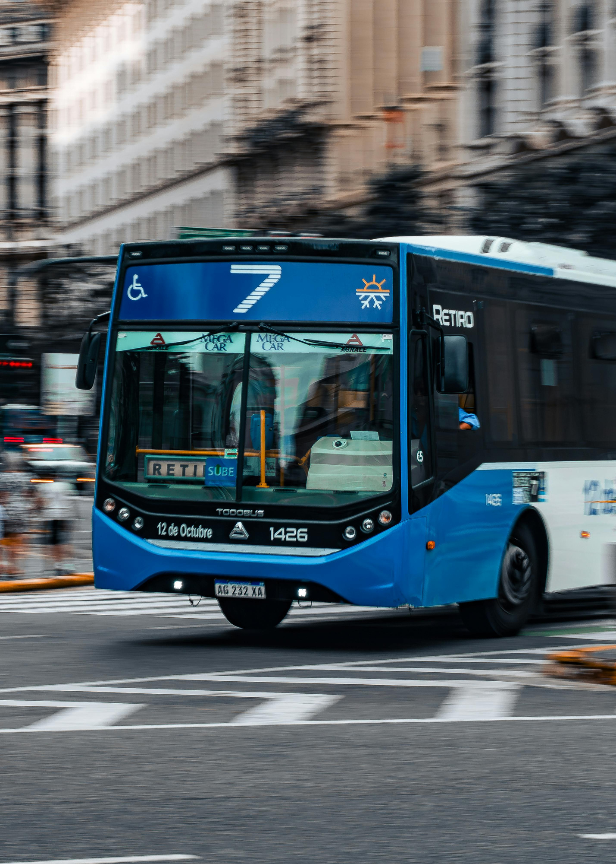

BusSync — AI-Powered Campus Transport Management System
Dynamic Route Updates Using an AI Agent | Divyanshi Solanki | IBM SkillsBuild Internship

Slide 2

Current Operational Challenges
Fragmented Communication Causes Chaos in Campus Transportation
Information Lag
Manual Dependency
Lack of Infrastructure
Last-minute bus route changes and merged stop updates fail to reach students and staff in real-time, resulting in widespread daily scheduling confusion.
Reliance on individual drivers and conductors to relay updates manually leads to frequent operational delays and the rapid spread of inaccurate route data.
The absence of a centralized digital platform prevents syncing transit office decisions directly with the mobile devices of the student body effectively.

Slide 3



Alignment to Sustainable development Goals
BusSync advances global sustainability through institutional value, access, innovation, and reduced carbon impact.
Quality Education
Industry & Innovation
Sustainable Communities
Ensures uninterrupted access to campus for all learners by effectively removing transport-related barriers.
Digitizes legacy institutional transport management by applying advanced AI and modern cloud infrastructure.
Enables reliable, accessible campus transport that reduces carbon footprints by optimizing bus route occupancy.

Slide 4
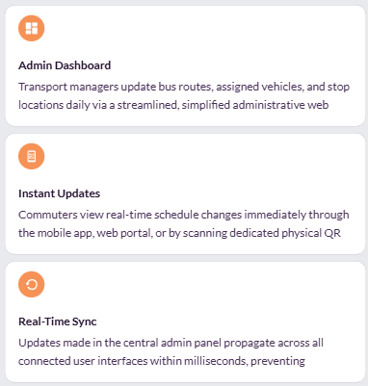

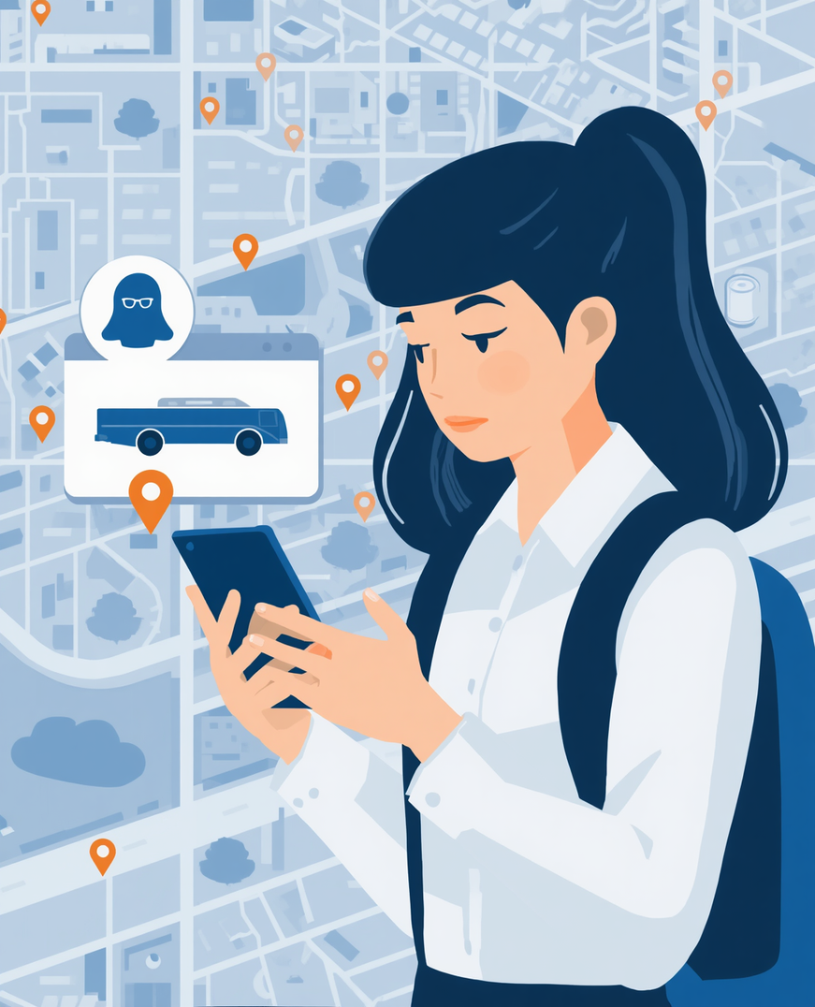
BusSync — Centralized Platform
BusSync serves as a unified web and mobile interface designed to bridge communication gaps, ensuring seamless coordination between transit administrators and daily commuters.

Slide 5
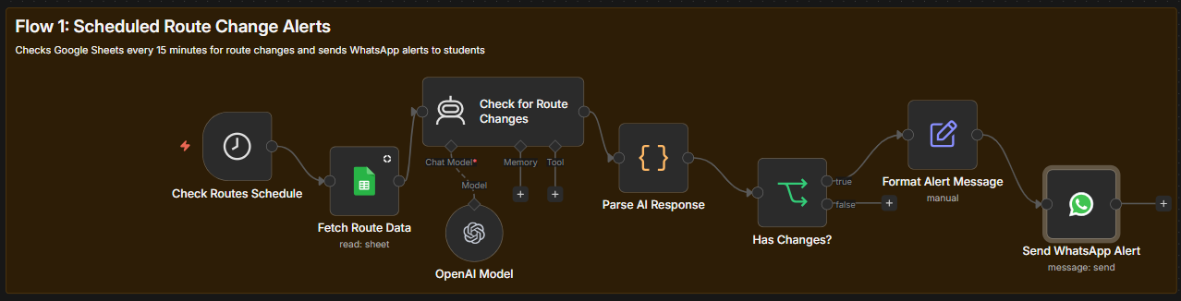
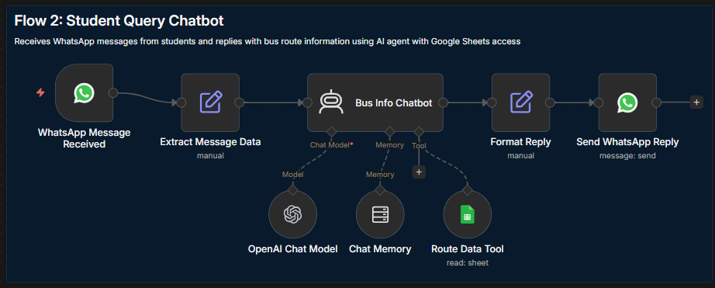

AI
AI
AGENT
AGENT

Slide 6
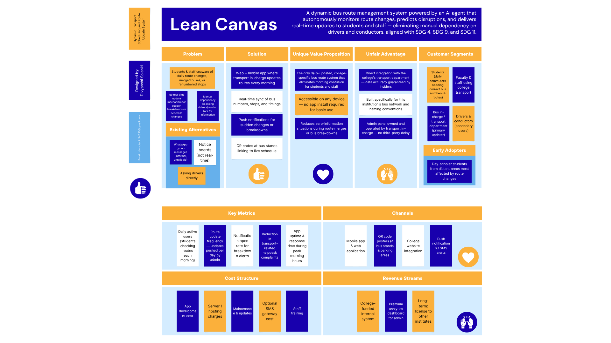
LEAN
CANVAS - BusSync

Slide 7
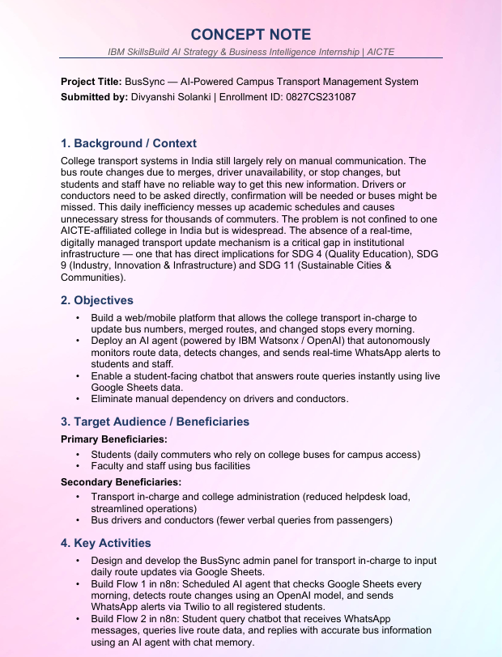
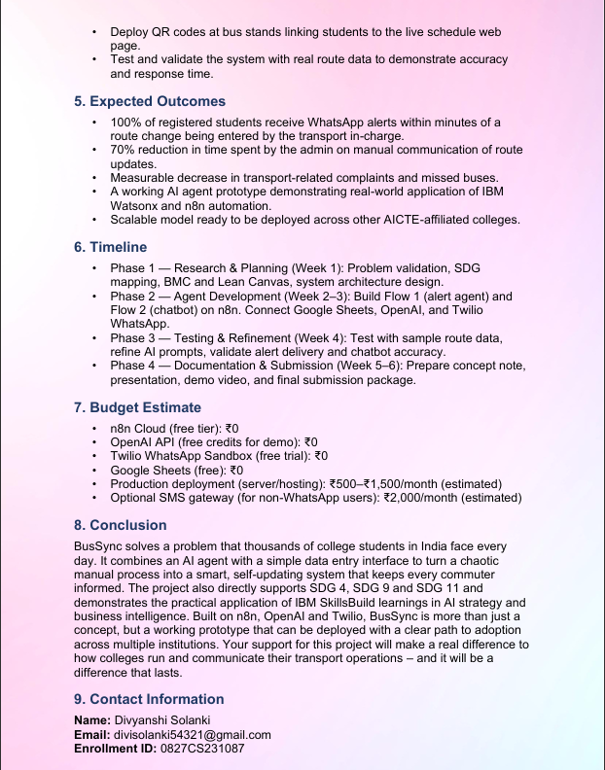
CONCEPT NOTE

Slide 8


Thank you
Divyanshi Solanki
divisolanki54321@gmail.com
IBM SkillsBuild AI Strategy & Business Intelligence Internship

